Slide 1


Retro fits
John Kobs

Slide 2

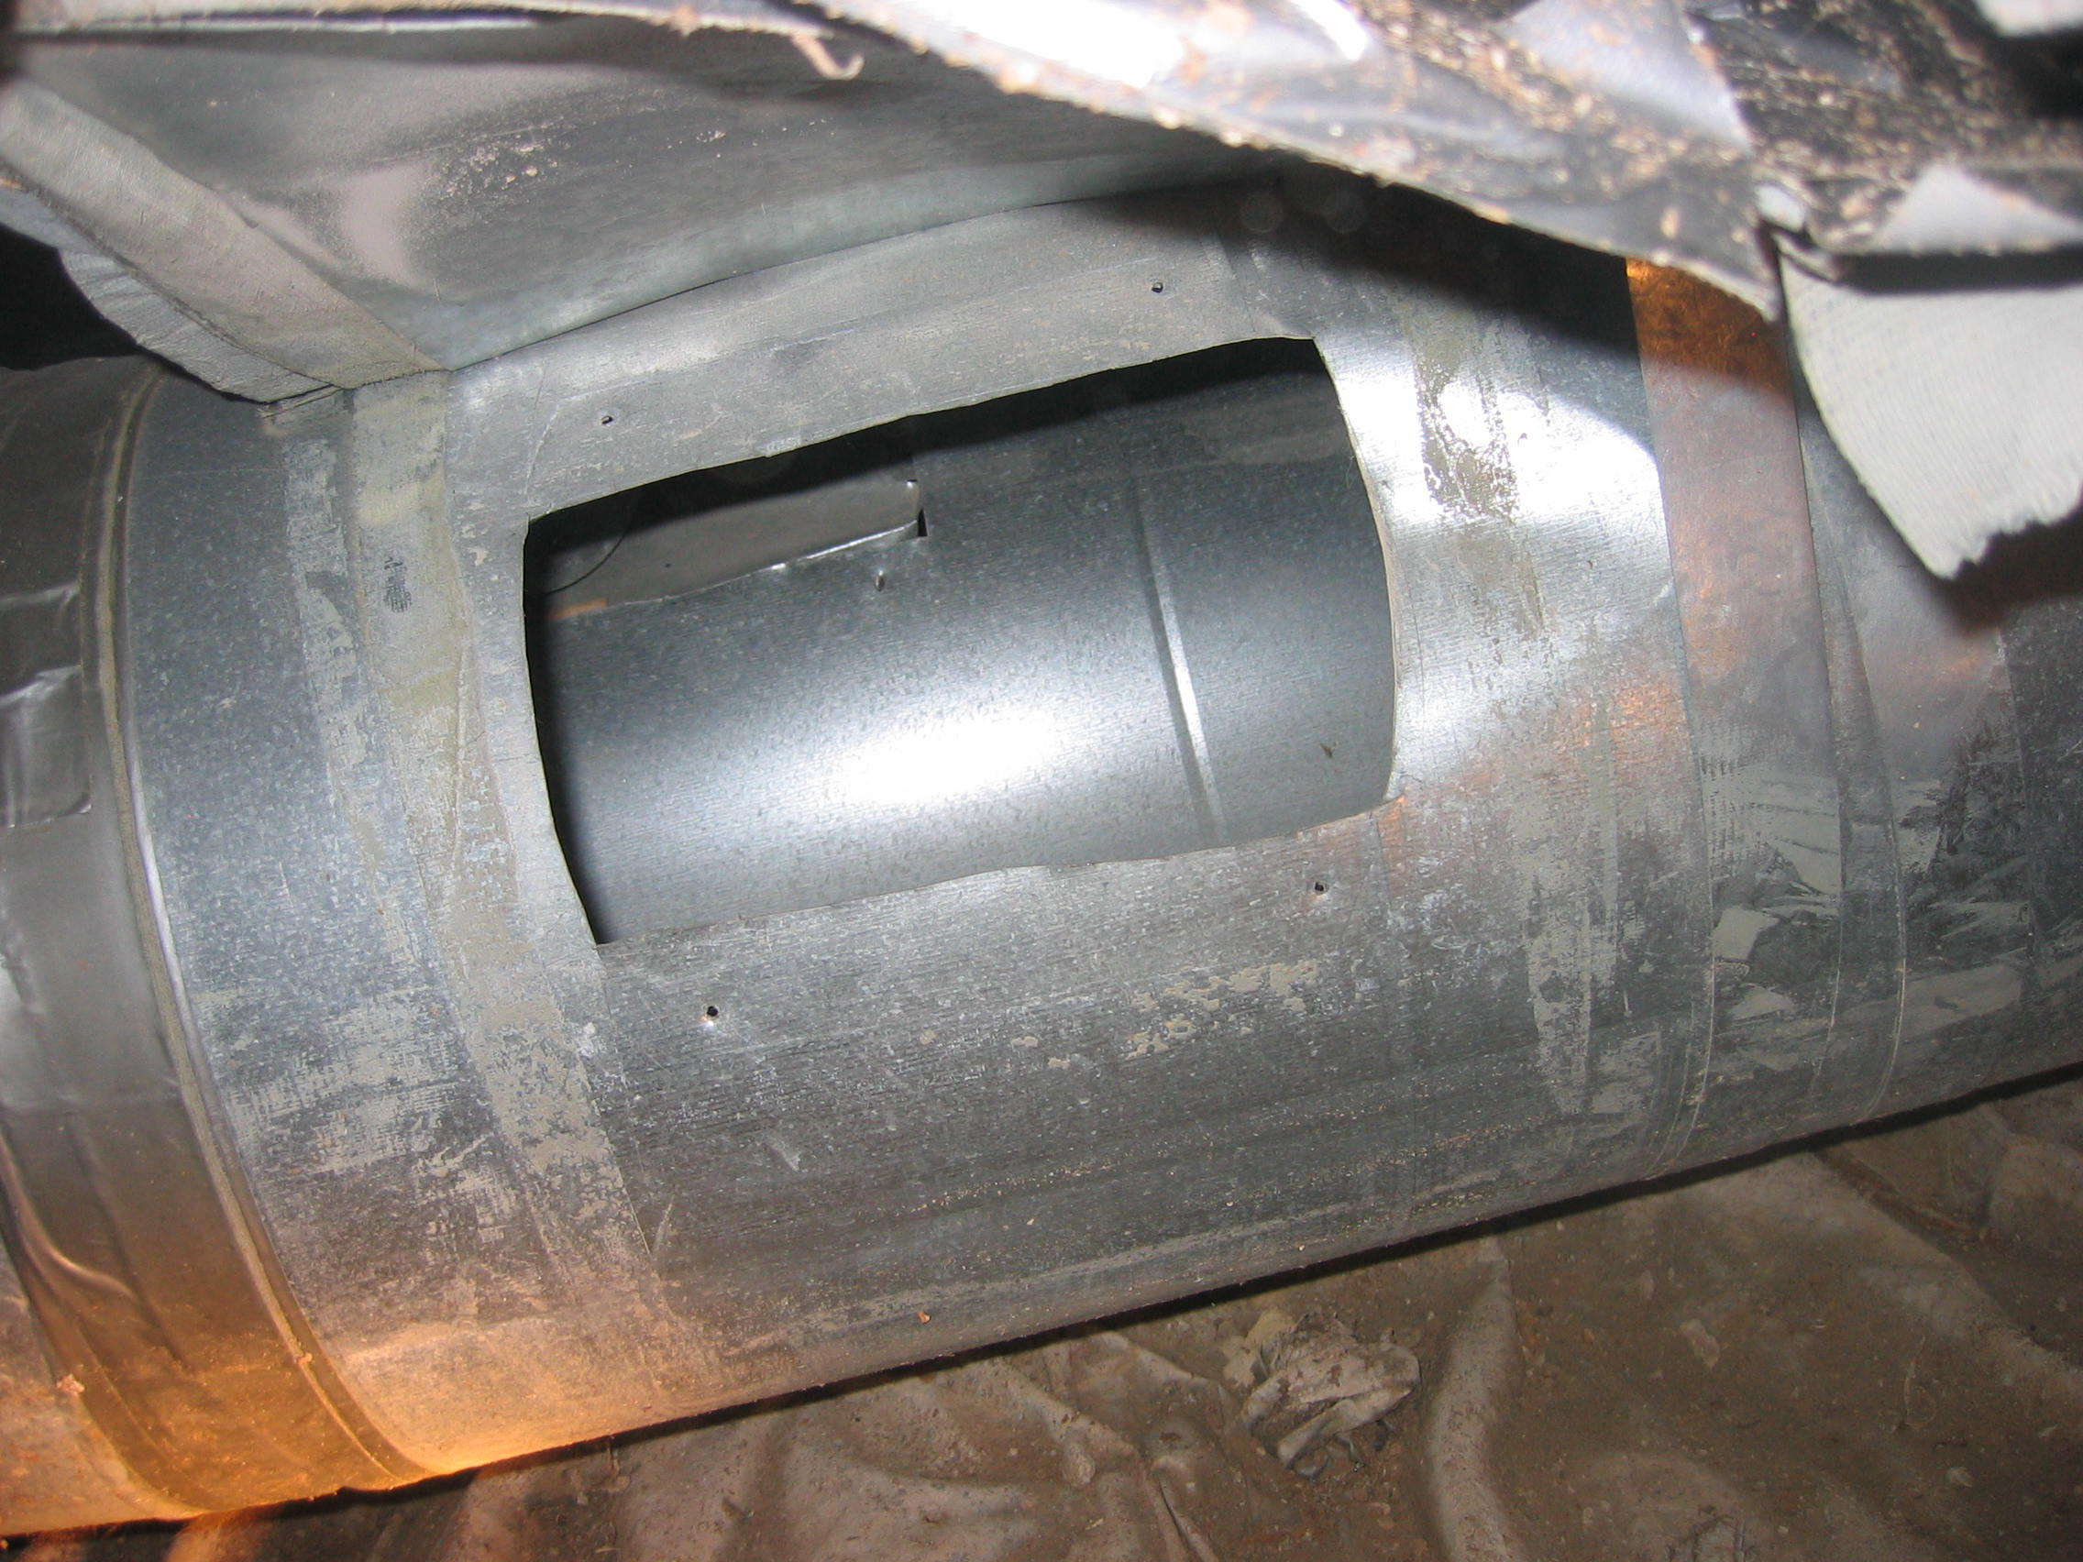

Slide 3

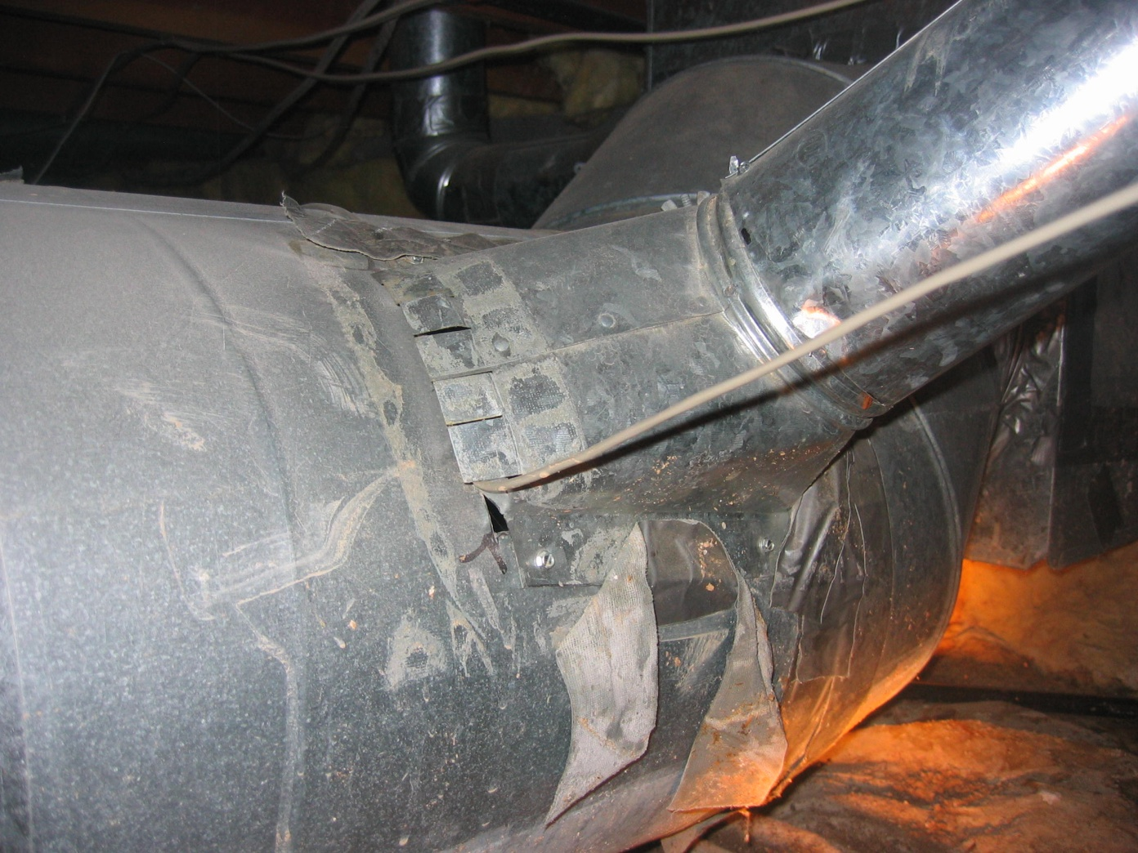

Slide 4

Market Place
EPA, Save 20% on energy
Costs*.

Slide 5
DIY Consumer
Switched out Duct Work.
Added attic insulation and subfloor insulation.
20% savings!!!

Slide 6
Energy Audits
Where do they come from?
  Refferals:

Slide 7
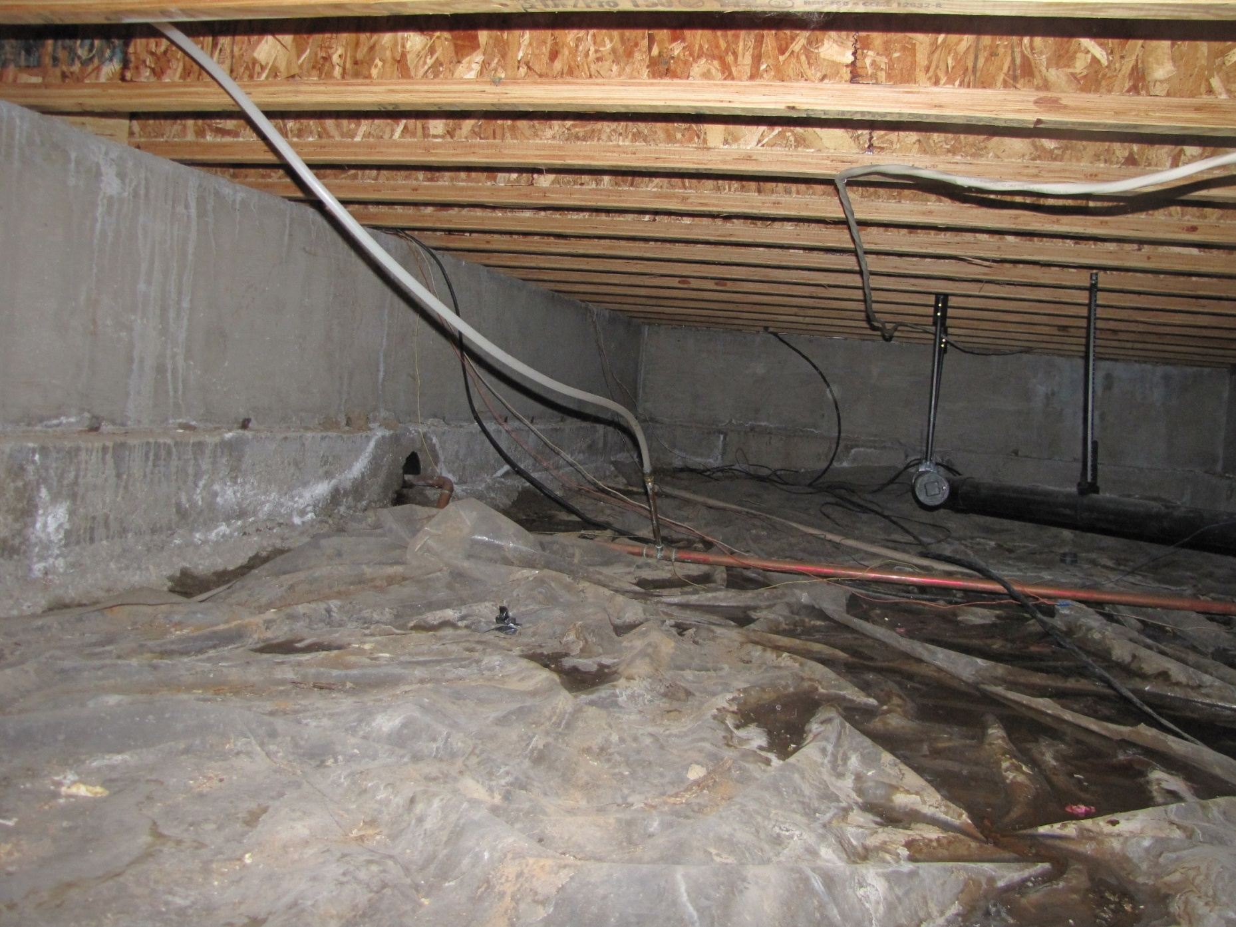

Slide 8
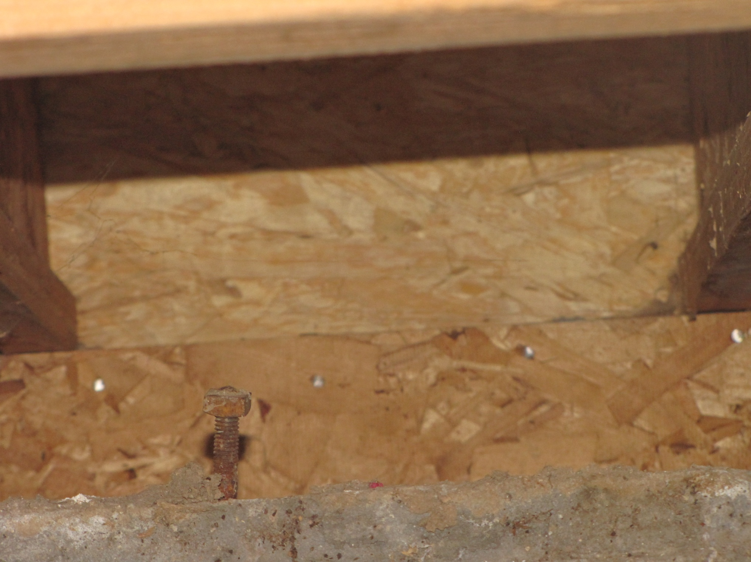

Slide 9
Energy
It’s a great thing, brought a new market place.

